Slide 1
Environmental Ethics

Slide 2
What Does Ethics Mean?
Dictionary:
“A discipline dealing with what is good and bad, with moral duty and obligation”
“A set of moral principles or values that an individual or a group follow”

Slide 3
Why Do We Need Ethics?
To establish a sense of right and wrong at every level of society:
- individual
- communal
- organizational
- national
- global

Slide 4
Ethics is the preferable way society can achieve the “right” decisions without having to use
- codes
- laws
- courts
- diplomacy
- boycott
- physical force

Slide 5
Environmental Ethics
“Expands a circle or moral concern beyond the human species to include at the very least other mammals; perhaps lower animals and plants; and finally entire ecosystems.”
Gudorf and Hutchison

Slide 6
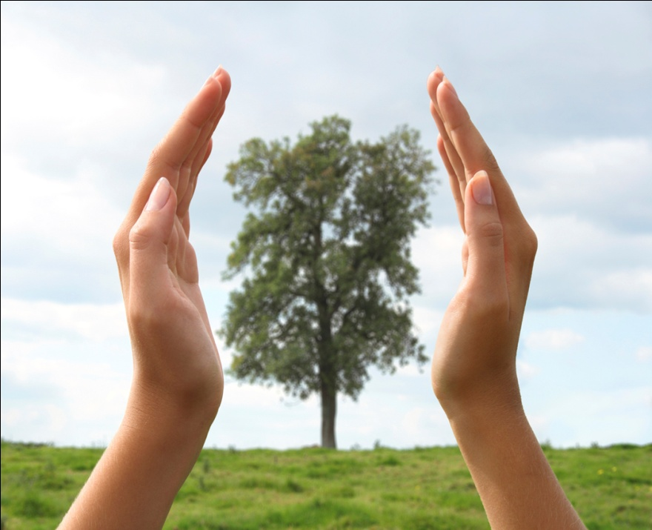
Environmental Ethic
The body of moral principles or values followed by a person in regards to their total surroundings.

Slide 7
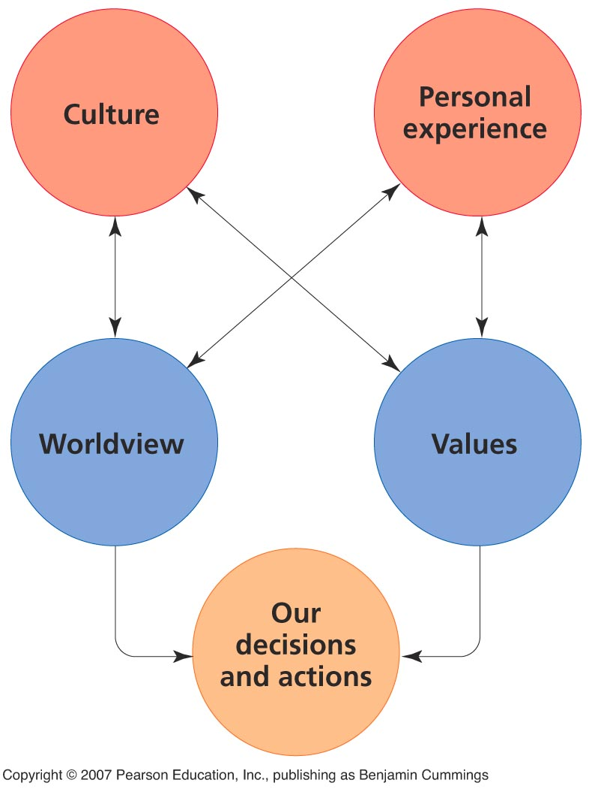
Ethics and economics
Both disciplines deal with how we value and perceive our environment.
These influence our decisions and actions.

Slide 8
Environmental ethics
Ethics = the study of good and bad, right and wrong
Ethical standards = criteria that help differentiate right from wrong
Environmental ethics = the study of ethical questions regarding human interactions with the environment

Slide 9
Ethicists
Relativists = Ethics should and do vary with social context
Universalists = Objective notions of right and wrong exist across all cultures and situations.

Slide 10
Some questions in environmental ethics
Should the present generation conserve resources for future generations?
Are humans justified in driving other species to extinction?
Is is OK to destroy a forest to create jobs for people?
Is it OK for some communities to be exposed to more pollution than others?
The answers depend, in part, upon the ethical standard you choose to use.

Slide 11
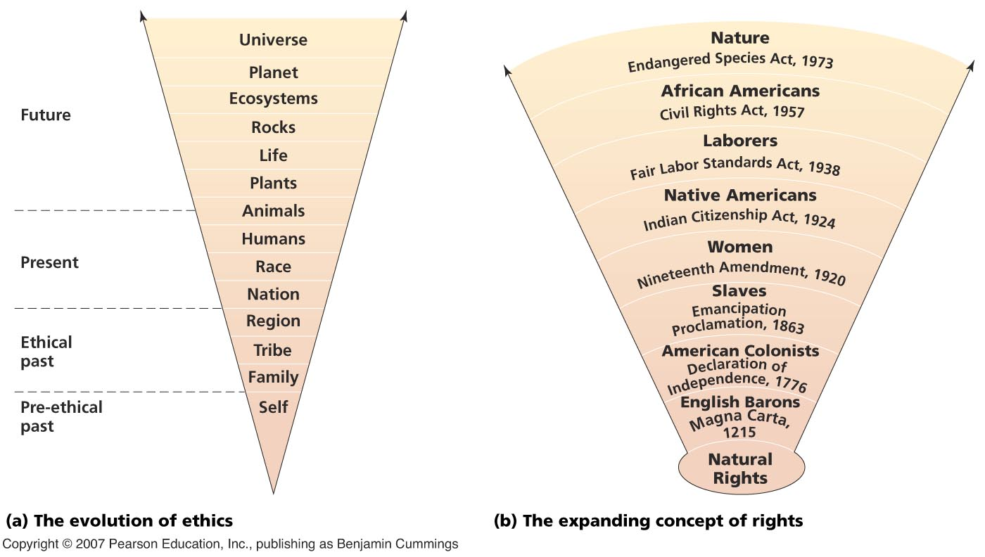
Expansion of ethical consideration over time

Slide 12
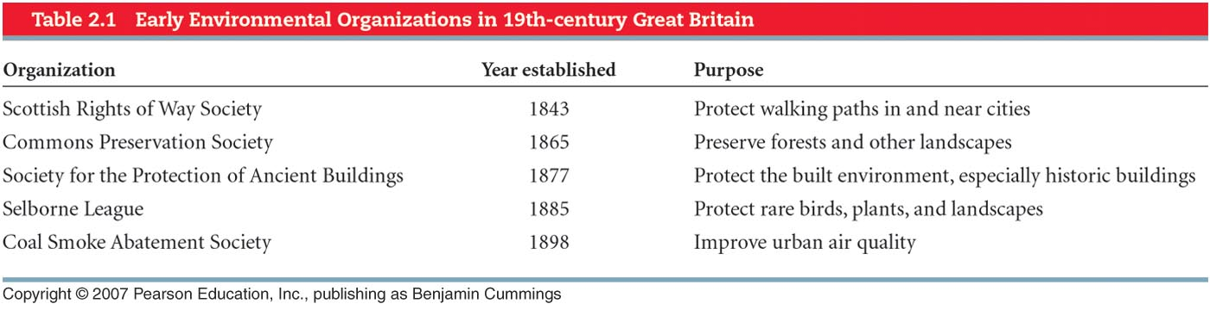
Early environmental ethics
The roots of environmental ethics are ancient.
The modern urge for environmental protection grew with problems spawned by the industrial revolution.

Slide 13
“People have a right to what they produce themselves, but man has another right, declared by the fact of his existence—the right to use of so much of the free gifts of nature as may be necessary to supply all the wants of that existence, and which he may use with interference with the equal rights of anyone else; and to this he has title against all the world.” Henry George, Progress and Poverty, 1874

Slide 14
“According to the Public Trust Doctrine, the public owns common or shared environments—air, waters, dunes, tidelands, underwater lands, fisheries, shellfish beds, parks and commons, and migratory species. . . . These things ‘are so particularly the gifts of nature’s bounty that they ought to be reserved for the whole of the populace.’ (Joseph L. Sax, 1970).”

Slide 15
"The people have a right to clean air, pure water and to the preservation of the natural, scenic, historic and aesthetic values of the environment. Pennsylvania's public natural resources are the common property of all the people, including generations yet to come.” ~ Article 1, Section 27 of the Pennsylvania Constitution

Slide 16
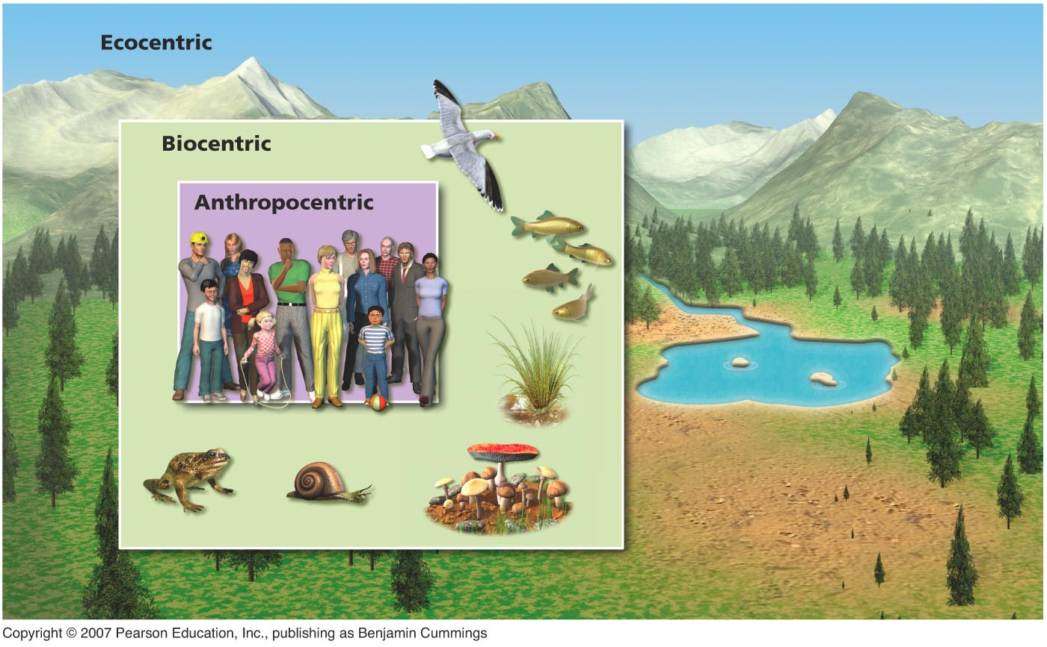
Three ethical worldviews

Slide 17
Examples of
Ethical Environmental Issues
Should we allow scientific research to be performed on animals?
Should we restore the ecosystems which were destroyed by hazardous wastes?
Should humans have more rights in this biosphere than other species?
Should we protect endangered species?
Should we restore the lands we destroyed?

